Slide 1
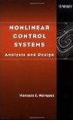
ECE 874 Course Organization
Instructors:
  Timothy Burg, tburg@clemson.edu
Book: Marquez – Nonlinear Control Systems – Analysis and Design
  You need access to the book. We will follow the organization of the book fairly closely.
Additional class notes will be provided.
All notes and solutions will be distributed using the class website and grades will be communicated using Blackboard. The website is located at http://www.eqpoint.info/nonlinearcourse
You may need to install a trail version of MathType to view the fonts in the slides (the fonts remain on the system even after the trial expires). See: http://www.dessci.com/en/support/mathtype/tsn/tsn50.htm
Office Hours: MWF 8-10 and as needed (email for appointment). 1058-C Rathbone Hall

Slide 2
ECE 874 Course Organization
Homework at 5% and four tests equally weighted at 23.75% will constitute the final grade.
Test Dates:
  Wednesday February 5, 2015
  Wednesday March 5, 2015
  Wednesday April 2, 2015
  Tuesday April 29, 2015 (regular exam period 8:00 am - 10:30 am)
The exams will have two parts:
  In-class portion taken during the regular class or exam period. The in-class portion will be closed-book designed to test basic concepts and will be weighted at 80% of the test grade.
  Take-home component. The take-home section be open book and open notes and may include computer simulations and will be weighted at 20% of the test grade.
  Assume you are to work on all assignments alone unless told otherwise.

Slide 3
Modeling
System
Biological
Mechanical
Electrical
Chemical
Financial ?
Social ??
Goal as an engineer: Predict (and control) the “behavior” of the system.
Theory: a limited statement regarding the cause and effect in a specific situation. ¹
Inputs
Outputs
Model: A prediction of the cause and effect behavior of the system based on a theory. Since the hypothesis may be limited, the model may not represent the true nature of the system.
Internal
Behavior
Extreme Example: Harold Chestnut, IFAC Control Engineering Textbook Prize, formed the “Supplemental Ways of Improving International Stability (SWIIS) Foundation" to identify and implement "supplemental ways to improve international stability".¹ (i.e. how to manipulate the world for good)
1. http://en.wikipedia.org/wiki/Harold_Chestnut

Slide 4
What is Systems Engineering?
System
Internal
Behavior
System Engineering addresses:
“The need to identify and manipulate the properties of a system as a whole, which in complex engineering projects may greatly differ from the sum of the parts' properties … ”¹
Inputs
Outputs
1. Arthur D. Hall (1962). A Methodology for Systems Engineering. Van Nostrand Reinhold. ISBN 0442030460. via http://en.wikipedia.org/wiki/Systems_engineering

Slide 5
Linear Versus Nonlinear Systems
Linear System: Given two system inputs and their respective outputs:
then a linear system must satisfy
for any scalar values and .
System
Linear
Nonlinear
Tools are well developed to understand (e.g. stability) and control the behavior of linear systems.
Nonlinear System: Not a linear system.
Tools are less well developed and less general.

Slide 6
ECE 874 Course Overview
Book: Marquez – Nonlinear Control Systems – Analysis and Design
  Background and Mathematical Tools (Chp 1-2)
  Lyapunov Stability (Ch 3, 4)
    What can we say about the time evolution of a system’s states?
  Stabilization (Ch 5)
    Controlling a nonlinear system
  Input-Output Stability (Ch6)
    Interconnected systems
  Dissipative (Ch 8, 9)
  Feedback linearization (Ch 10, 11)
  Observer Design (Ch 11)
Additional class notes.

Slide 7
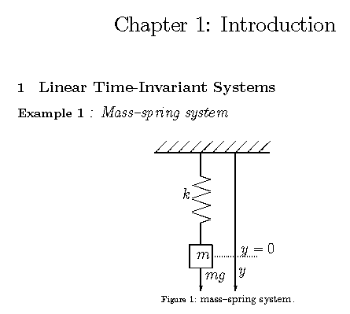

Slide 8
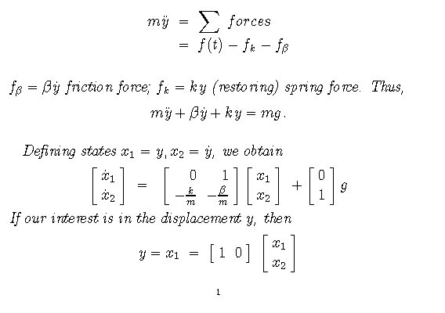
f_{k} (spring)
f_{β} (damping)
f(t) (input forces - gravity)
Time Invariant:
f(t) =mg and is not explicitly dependent on time
Linear differential equation
x₁ = position
x₂ = velocity
Linear Model:
No multiplication, square, sin(), etc of the states x₁ and x₂

Slide 9
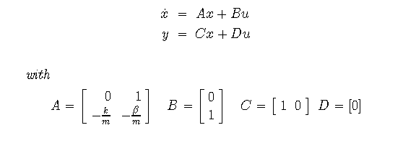
State-space form of the linear model of the mass-spring-damper system
State-space form

Slide 10
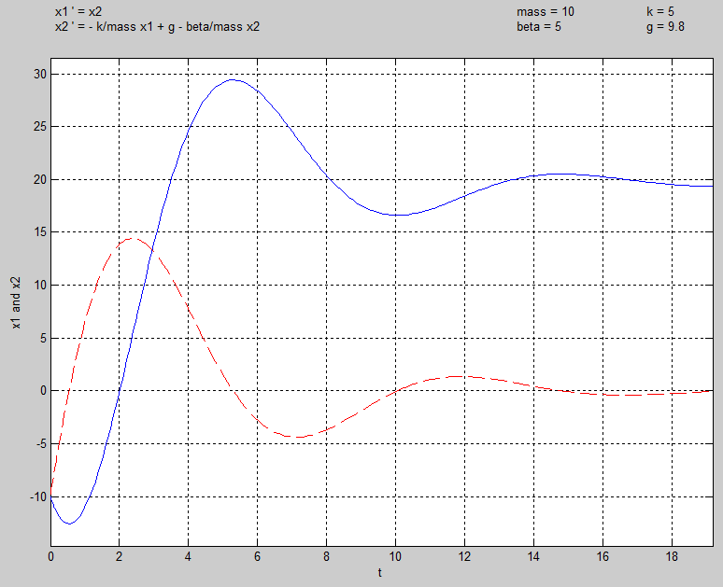
Simulation of the response of the system to initial conditions
Initial
Condition
-10
x₂ = velocity of mass
0
Equilibrium
Condition
20
x₁ = position of mass
Time

Slide 11
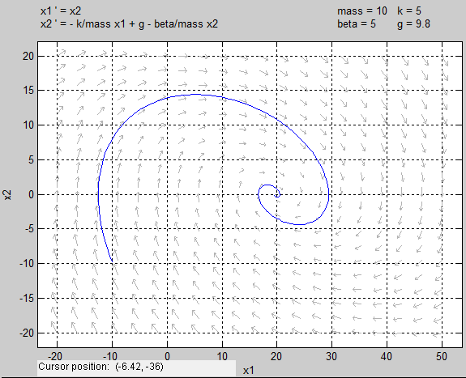
A phase portrait is a plot of the trajectories of the states of a dynamical system. Each initial condition produces a curve or point.
Plot the trajectory of the states.
States individually versus time
State x₂ versus State x₁
x₁
x₂
3
4
2
x₂
1
x₁
1
2
3
4
Plots made using pplane8.m software an MATLAB

Slide 12
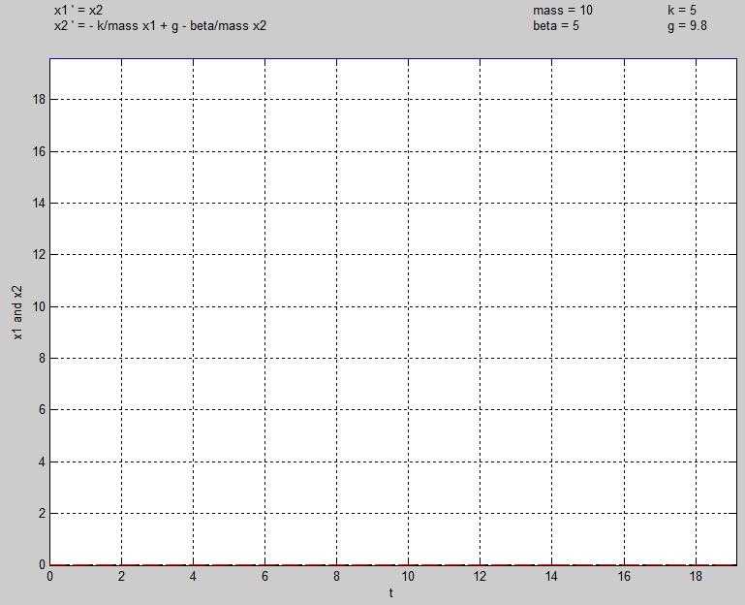
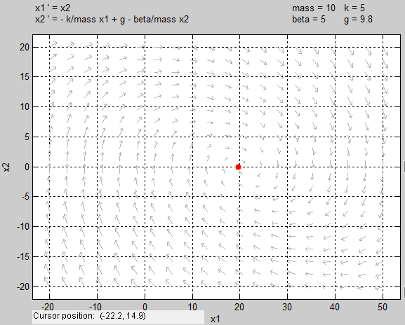
A phase portrait is a plot of the trajectories of the states of a dynamical system. Each initial condition produces a curve or point.
States individually versus time
State 2 versus State 1
Burg using pplane8.m
x₁
System response to initial condition:
x₁ =19.6 and x₂ =0
3
x₂
2
4
1
x₂
x₁
1
2
3
4
Special point from which trajectory doesn’t move is called a critical point.
Solve by setting the derivatives = zero.

Slide 13
The vector field arrows help sketch the system:
*

Slide 14
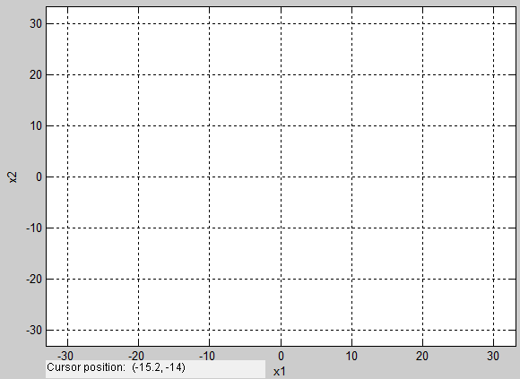
For the mass-spring-damper example:
x₁ | x₂ | f₁ | f₂
0 | 0 | 0 | 9.8
19.6 | 0 | 0 | 0
10 | 0 | 0 | 4.8
30 | 0 | 0 | -5.2
20 | 10 | 10 | -.2
20 | 5 | 5 | -.2
15 | 5 | 5 | 2.3
Plot enough points to sketch the trajectories.

Slide 15
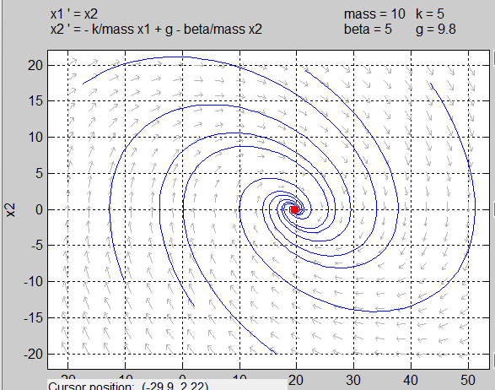
A phase portrait is a plot of the trajectories of the states of a dynamical system. Each initial condition produces a curve or point.
- are the initial conditions
Burg using pplane8.m
Mostly interesting for second- or third-order systems.

Slide 16
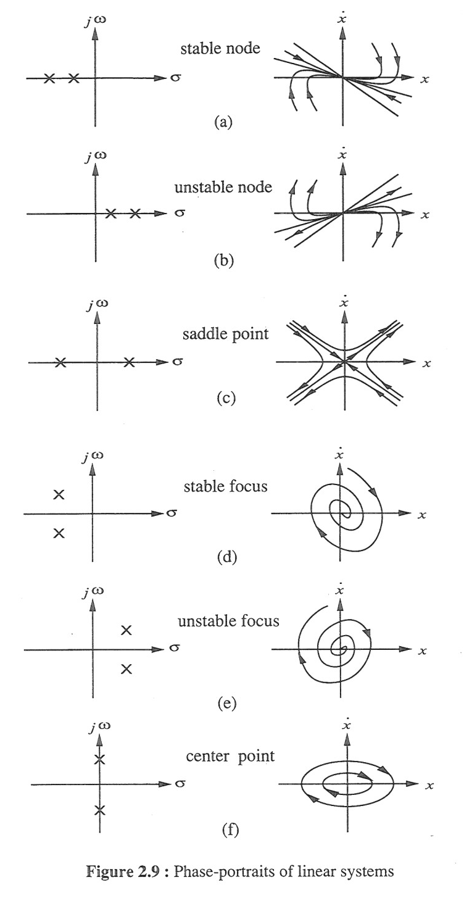
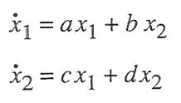
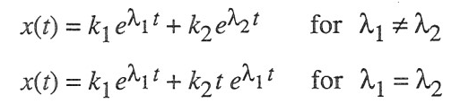

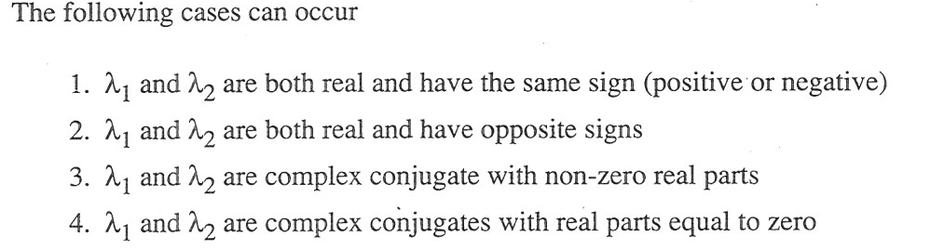
Phase portraits of linear systems are well defined
Example
If we change the parameters in the mass-spring-damper system, which of these plots can we have?
Slotine and Li, Applied Nonlinear Control, page 33,

Slide 17
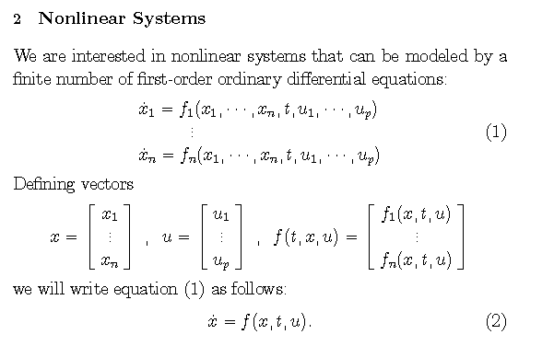
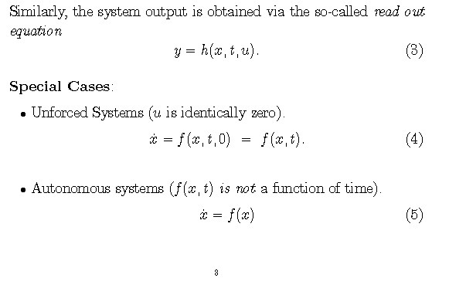
n^{th} order differential equation
Multi-input
Explicit dependence on time is possible
MIMO = Multi-Input Multi-Output
SISO = Single-Input Single-Output
Multi-output

Slide 18
Not an Explicit dependence on time (doesn’t appear directly, also called “time invariant”)
Still have an Implicit dependence on time (states vary with time , also called “time varying”)

Slide 19
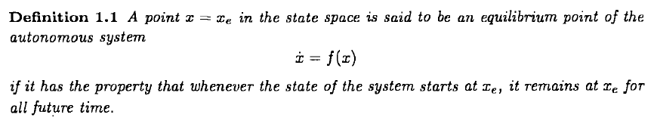
Mass doesn’t move from the point where gravity and spring force balance (net force is zero) when there is no velocity (no kinetic energy).

Slide 20

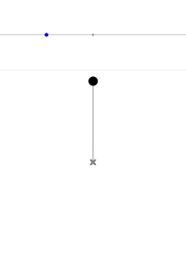

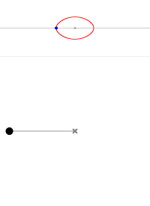
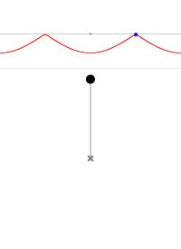
Phase Portrait
Pendulum
Equilibrium
Point
Phase Portrait
"Pendulum 190deg" by Lucas V. Barbosa (Kieff) - Own work. Licensed under Public Domain via Wikimedia Commons - http://commons.wikimedia.org/wiki/File:Pendulum_190deg.gif#mediaviewer/File:Pendulum_190deg.gif
http://en.wikipedia.org/wiki/Pendulum_(mathematics)#math_Eq._1

Slide 21
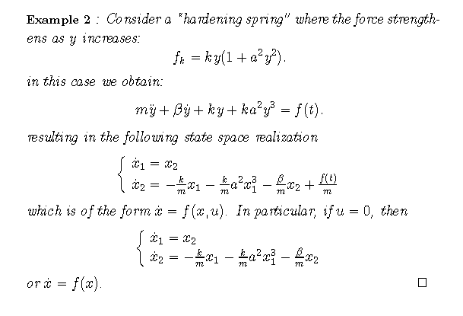
Makes this nonlinear
This is an autonomous system
Can we “solve” the nonlinear differential equation directly?
Not in general
But this model still has useful information
Most of the tools we develop will tells us about the system without actually “solving” the system.

Slide 22
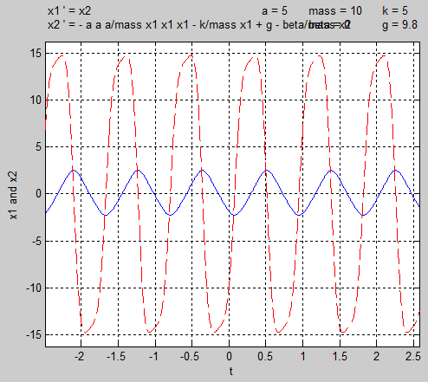
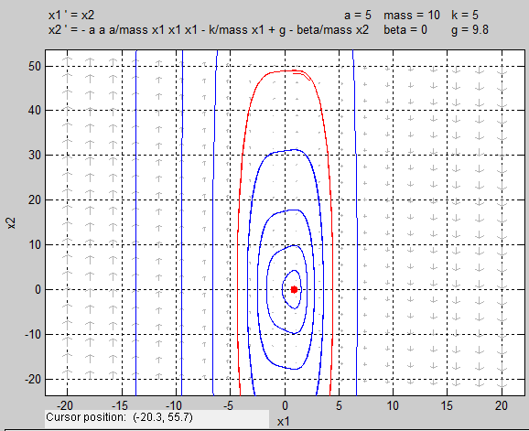
Equilibrium point
In Matlab:
>P=[-a^2*k/m 0 –k/m g]
>roots
>0.9076, -0.45+j0.8, -0.45-j0.8,

Slide 23
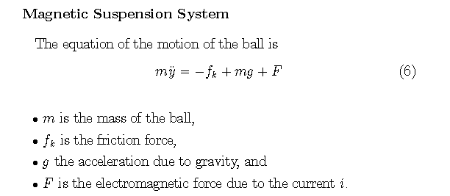
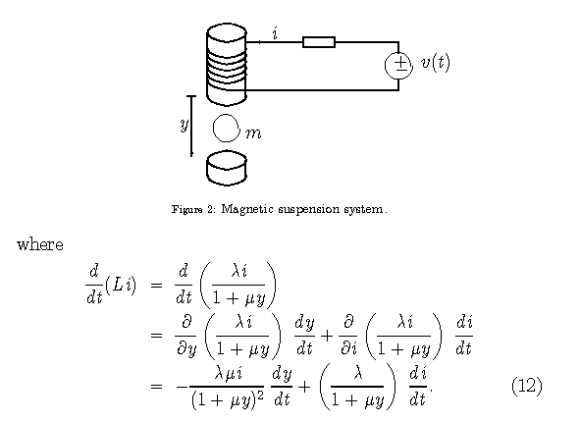
(Electromechanical System)
(Mechanical Sub-system)
This will create a strong nonlinearity
(from the air)
f_{k}
Input voltage creates current in the magnetic winding which produces a force on the ball.
Resistor
mg
F
Ball
As a control problem, you would control v(t) with a computer and measure the ball position in order to control the ball’s (vertical) position.

Slide 24
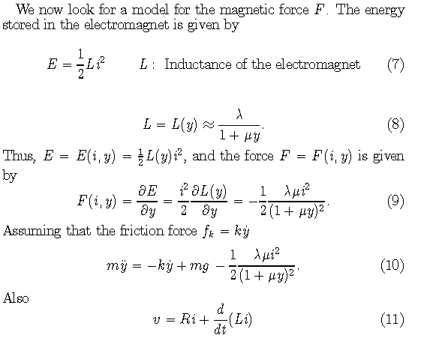

Geometric and material properties – constants.
L
y
2nd order system
Always F<0, pulls ball to coil
Notes:
Plot of actual inductance: http://cegt201.bradley.edu/projects/proj2003/maglev/

Slide 25
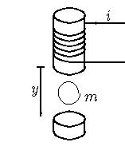

What have we achieved?
(Mechanical Sub-system)
Are we finished?
Depends on how we create current.

Slide 26
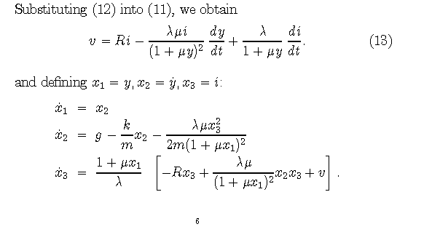
(Electrical Sub-system)
L(y)
+
v(t)
+
v_{R}
R
-
-
1st order system

Slide 27
Repeating:
Ball position, ball velocity, current
“Chained” system
Linearized model does not work well for this system.
Roughly:
Apply voltage (v) -> produces current (x₃) -> produces force (x₃²) -> positions ball (x_{1 ,}x₂)
Electrical
(Mechanical Sub-system)
X₃(t)
X₂(t)
X₁(t)
V(t)

Slide 28
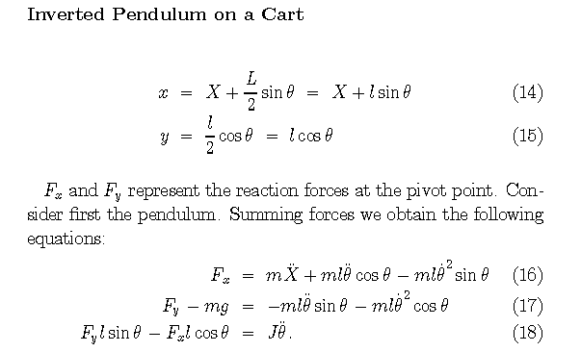
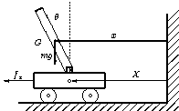
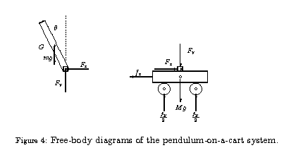
Coordinates of the center of mass
L
Input force f_{x}

Slide 29
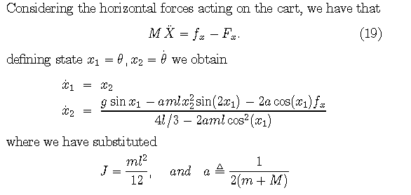
4th order differential equation
As a control problem, you would control f_{x} with a computer and measure the pendulum position in order to balance the pendulum.
A linearized model can be used to control the system.

Slide 30
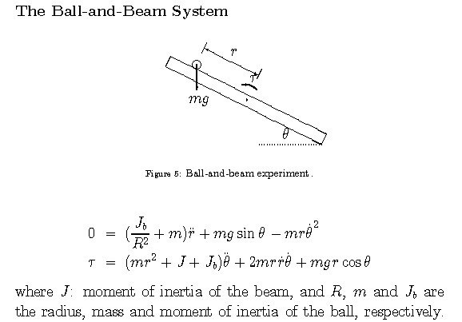

Slide 31
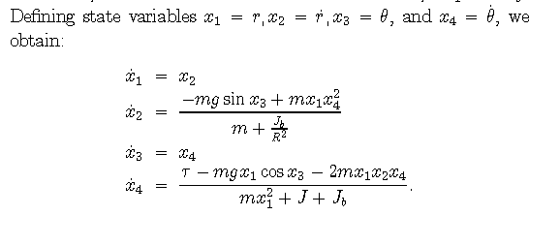
As a control problem, you would control τ(t) with a computer and measure the ball position in order to control the ball’s position along the beam.

Slide 32
Chapter 1 Conclusions
Hopefully you are convinced that there are interesting problems that are nonlinear and are motivated to learn new analysis and control techniques.

Slide 33

Homework 1
Download and install PPlane8 software (address on website)
  2D phase portraits
Problems 1.1 (the requested plot is not a phase portrait), 1.2, 1.4
Use PPlane8 to reproduce the phase portraits (PPs) for the linear system examples 1.7-1.11
Use PPlane8 to draw PP of equations 1.25 and 1.26 with μ=1, what happens for other values of μ? (Use axes limits -4<x₁,x₂<4)
Plot PP of system (use axes limits -2<x₁,x₂<2)
Plot PP of system (use axes limits -2<x₁,x₂<2)
Find the equilibrium point(s) for the state-space model in the magnetic suspension example. Assume all parameters are 1 except g and assume a constant applied voltage v.

Slide 34
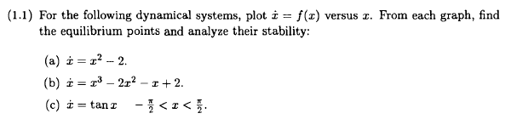
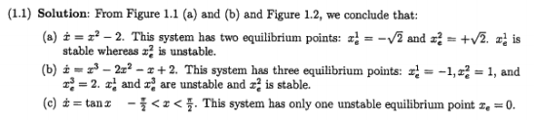
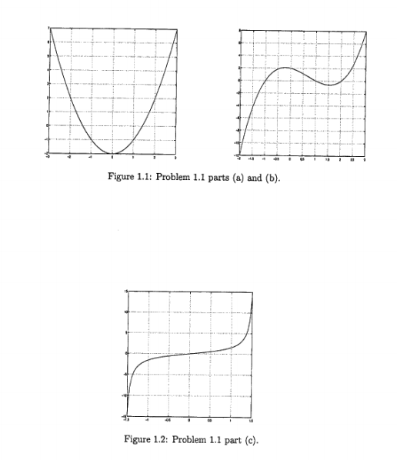
Homework – Solution
Part 1.a

Slide 35
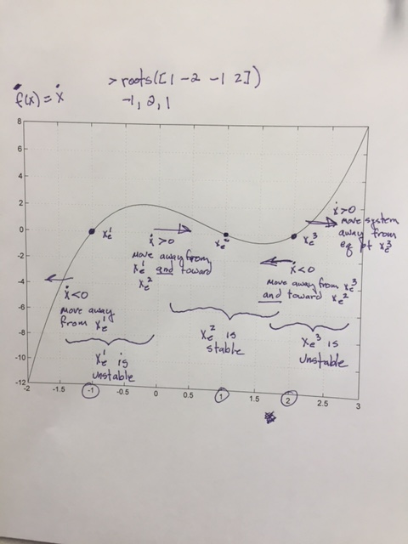
Part 1.b
Homework – Solution

Slide 36

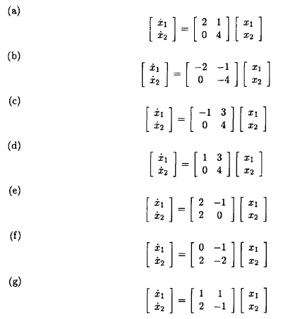
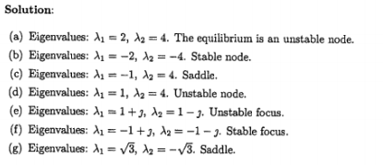
Homework – Solution

Slide 37
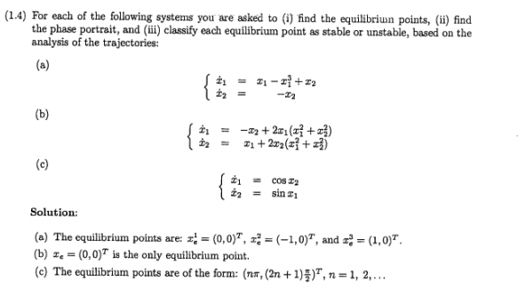
Homework – Solution

Slide 38
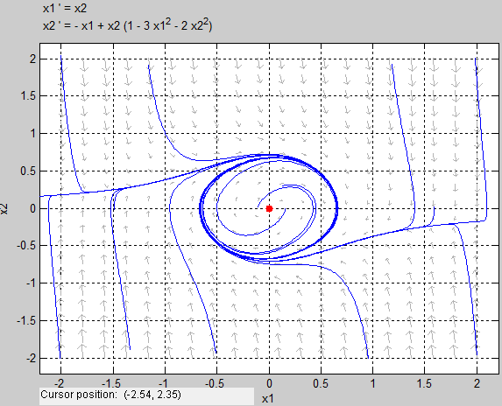
Homework – Solution
Example: Nonlinear System, Khalil, Nonlinear Systems, 3rd ed, page 78
Burg using pplane8.m

Slide 39
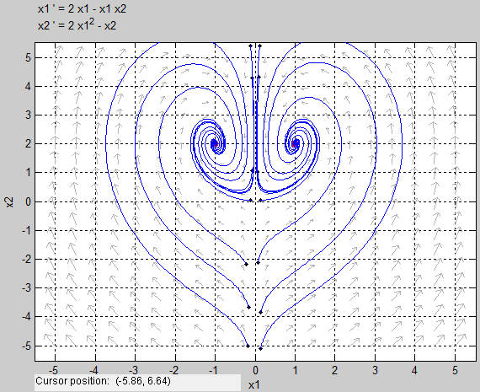
Homework – Solution
Example: Nonlinear System, Khalil, Nonlinear Systems, 3rd ed, page 78, prob 2.4-(2)
Burg using pplane8.m

Slide 40
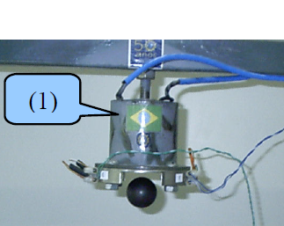
Homework – Solution
For a constant voltage
X₁
Notes:
http://www.abcm.org.br/pt/wp-content/anais/cobem/2009/pdf/COB09-0284.pdf

Slide 41
Homework – Solution
Equilibrium point for the state-space model in the magnetic suspension:

